Slide 1
COMPUTER NETWORKS
Chapter 01
Introduction (1)
Computer Networks -1-Part 1

Slide 2
Historic Review
ENIAC: 1946, the very first computer
ARPANET: 1969, the very first computer network for advanced research project agent of defense department, USA.
Internet: 1986
National Information Infrastructure: 1993
Commercialized Internet: 1995
NGI: 1995, next generation internet
I2: 1996, Internet2
CNGI: Cernet2 + …
Computer Networks -1-Part 1

Slide 3

Internet History
1961-1972: Early packet-switching principles
1961: Kleinrock - queueing theory shows effectiveness of packet-switching
1964: Baran - packet-switching in military nets
1967: ARPAnet conceived by Advanced Research Projects Agency
1969: first ARPAnet node operational
1972:
  ARPAnet public demonstration
  NCP (Network Control Protocol) first host-host protocol
  first e-mail program
  ARPAnet has 15 nodes
Computer Networks -1-Part 1

Slide 4
Internet History
1972-1980: Internetworking, new and proprietary nets
1970: ALOHAnet satellite network in Hawaii
1974: Cerf and Kahn - architecture for interconnecting networks
1976: Ethernet at Xerox PARC
early 70’s: proprietary architectures: DECnet, SNA, XNA
late 70’s: switching fixed length packets (ATM precursor)
1979: ARPAnet has 200 nodes
Cerf and Kahn’s internetworking principles:
  minimalism, autonomy - no internal changes required to interconnect networks
  best effort service model
  stateless routers
  decentralized control
define today’s Internet architecture
Computer Networks -1-Part 1

Slide 5
Internet History
1980-1990: new protocols, a proliferation of networks
1983: deployment of TCP/IP
1982: smtp e-mail protocol defined
1983: DNS defined for name-to-IP-address translation
1985: ftp protocol defined
1988: TCP congestion control
new national networks: Csnet, BITnet, NSFnet, Minitel
100,000 hosts connected to confederation of networks
Computer Networks -1-Part 1

Slide 6
Internet History
1990, 2000’s: commercialization, the Web, new apps
Early 1990’s: ARPAnet decommissioned
1991: NSF lifts restrictions on commercial use of NSFnet (decommissioned, 1995)
early 1990s: Web
  hypertext [Bush 1945, Nelson 1960’s]
  HTML, HTTP: Berners-Lee
  1994: Mosaic, later Netscape
  late 1990’s: commercialization of the Web
Late 1990’s – 2000’s:
more killer apps: instant messaging, P2P file sharing
network security to forefront
est. 50 million host, 100 million+ users
backbone links running at Gbps
Computer Networks -1-Part 1

Slide 7
Internet History
2007:
~500 million hosts
Voice, Video over IP
P2P applications: BitTorrent (file sharing) Skype (VoIP), PPLive (video)
more applications: YouTube, gaming
wireless, mobility
Computer Networks -1-Part 1

Slide 8
Why Networking?
The integration of computers and communication techniques:
(1) communication network is the infrastructure for computer network;
(2) computer progress facilitates telecommunication
Computer Network = computer + communication
Why networking?
The needs for efficiently collecting, storing, processing, distributing and managing information
The needs for changing manner of using computers
The needs for changing manner of using networks
Computer Networks -1-Part 1

Slide 9
What is a computer network?
Tanenbaum’s definition
Computer network - Interconnected collection of autonomous computers
Our definition:
A system that interconnecting multiple autonomous computers in different locations with communication equipment, trunks, and communication software(OS, protocols, etc.), for resource sharing, is so called computer network.
Computer Networks -1-Part 1

Slide 10
Differences between computer networks and distributed system
Key distinction is that in a distributed system, the existence of multiple autonomous computers is transparent to users. It looks like a virtual machine with uniprocessor.
With a network, users must explicitly log on to one machine, explicitly submit jobs remotely, explicitly move files around and handle network personally.
Computer Networks -1-Part 1

Slide 11
Important conclusion
In effect, a distributed system is a software system build on top of network. The software gives it a high degree of cohesiveness and transparency. Thus the distinction between a network and a distributed system lies with the software (especially the operating system) rather than with the hardware.
Computer Networks -1-Part 1

Slide 12
Important conclusion
The Internet is not a single network but a network of networks and the Web is a distributed system that runs on top of the Internet.
Computer Networks -1-Part 1

Slide 13
1.1 Use of Computer Networks
Before we start to examine the technical issues in detail, it is worth devoting some time to pointing out why people are interested in computer networks and what they can be used for. After all, if nobody were interested in computer networks, few of them would be built. We will start with traditional uses at companies, then move on to home networking and recent developments regarding mobile users, and finish with social issues.
Computer Networks -1-Part 1

Slide 14
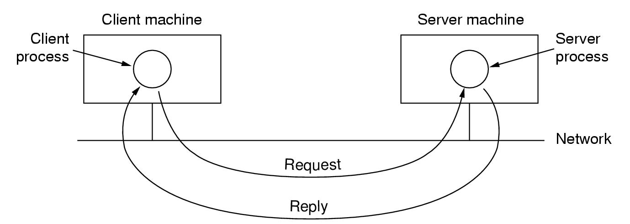
1.1.1 Business applications
Resource sharing, information sharing
High reliability
Saving money – client-server model
Scalability
Computer Networks -1-Part 1

Slide 15
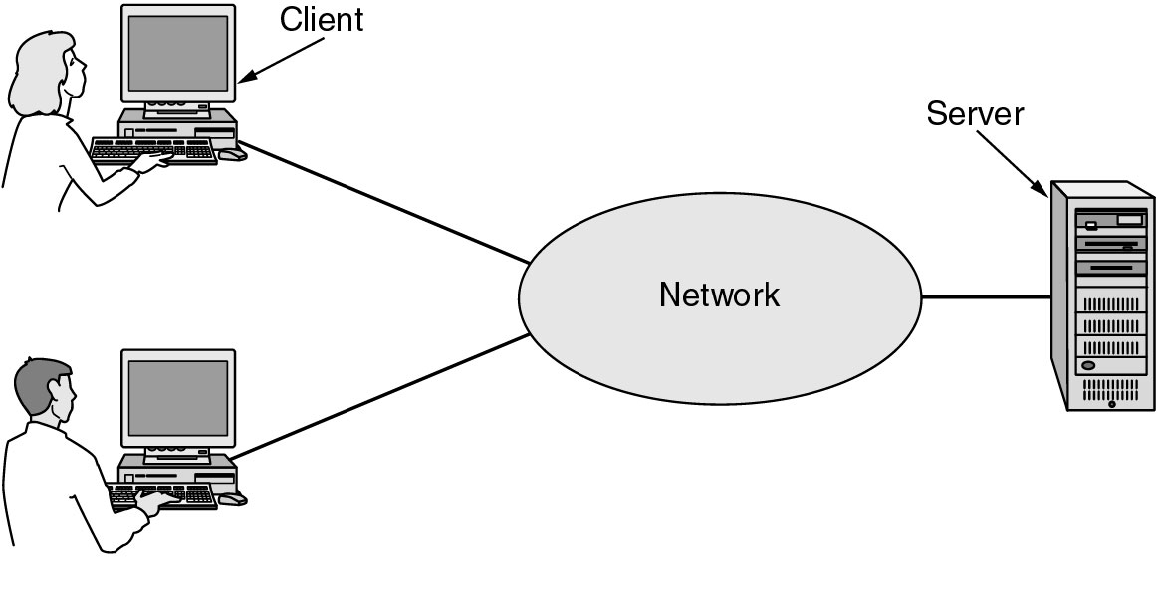
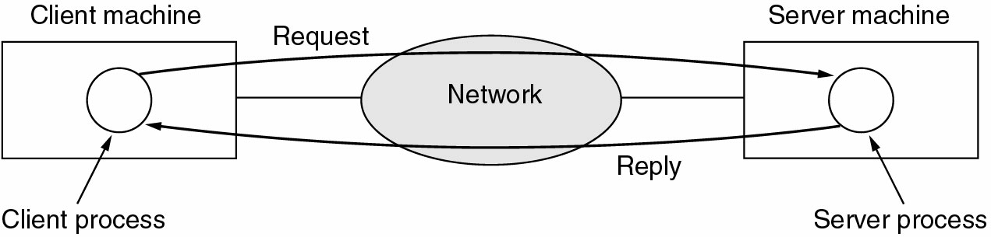
Business Applications of Networks
Fig. 1-1 A network with two clients and one server.
Fig. 1-2 The client-server model involves requests and replies
Computer Networks -1-Part 1

Slide 16
Business Applications of Networks
A computer network can provide a powerful communication medium among employees.
  e-mail (electronic mail)
  IP telephony or Voice over IP(VoIP)
  Videoconferencing
doing business electronically with other companies, especially suppliers and customers.
  This new model is called e-commerce (electronic commerce).
Computer Networks -1-Part 1

Slide 17
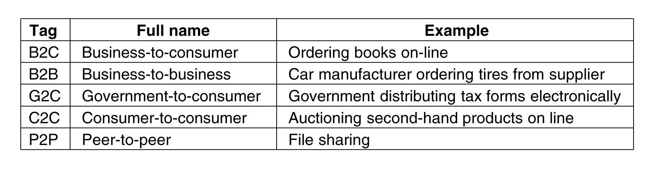
1.1.2 Home Network Applications
Access to remote information
Person-to-person communication
Interactive entertainment
Electronic commerce
Computer Networks -1-Part 1

Slide 18
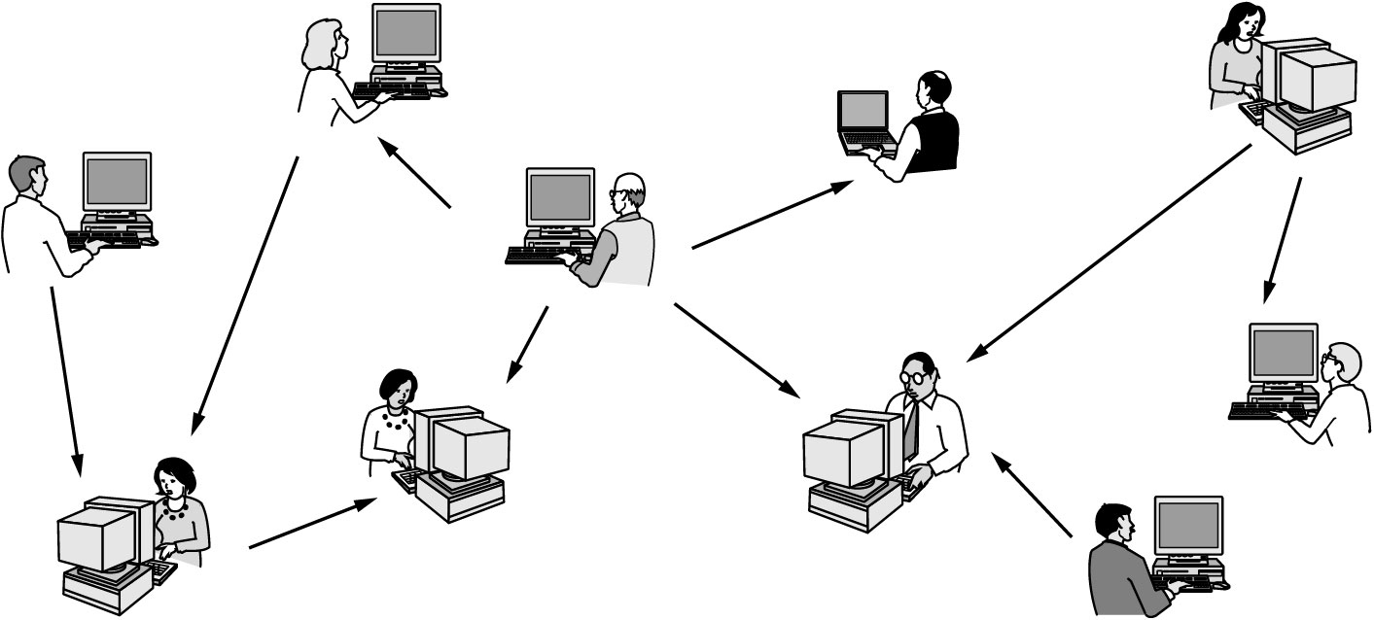
Home Network Applications (2)
Fig. 1-3 In a peer-to-peer system there are no fixed clients and servers, such as BitTorrent, and PPlive, Skype…
Computer Networks -1-Part 1

Slide 19
Home Network Applications (3)
Instant Messaging
  Allow two people to type messages at each other in real time
Twitter
  Multi-person messaging service
Social network
  Between person-to-person communications and accessing information
  Facebook
Wiki
  Groups of people can work together to create content
  Wikipedia: an encyclopedia anyone can edit
Computer Networks -1-Part 1

Slide 20
Home Network Applications (4)
IPTV(IP TeleVision)
  Based on IP technology instead of cable TV or radio transmissions
Game playing
  Multiperson real-time simulation games
Ubiquitous computing
  Computing is embedded into everyday life
  A technology called RFID (Radio Frequency IDentification) will push idea even further in the future. They may turn the real world into the Internet of things (IoT).
Computer Networks -1-Part 1

Slide 21
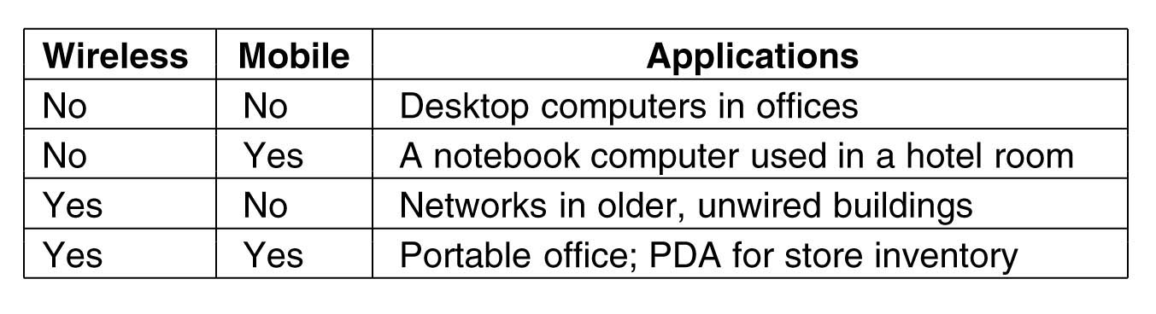
1.1.3 Mobile users
Wireless LAN
Fixed wireless and mobile wireless
Mobile phone: Text messaging or texting (Short Message Service), Smart phones, GPS (Global Positioning System)
m-commerce: mobile-commerce
Sensor networks
Wearable computers
Computer Networks -1-Part 1

Slide 22
Computer Networks Overview (1)
Hardware: Talk just a bit about how you can configure a bunch of computers into a network:
  Local Area Networks (LAN)
  Metropolitan Area Networks (MAN)
  Wide Area Networks (WAN)
  Internetworks
Software: This is what actually makes computer networks – not the hardware!
Computer Networks -1-Part 1

Slide 23
Computer Networks Overview(2)
Protocols: describe how two communicating parties exchange information.
Services: describe what a network offers to parties that want to communicate.
Interfaces: describe how a client can make use of network services, i.e. how the services can be accessed.
Reference models: Describe how the OSI and Internet networks are organized.
Computer Networks -1-Part 1

Slide 24
1.2 Network Hardware
Two types of transmission technology are in widespread use: broadcast links and point-to-point links
Broadcast network: a single communication channel is shared by all computers, that is, sending a packet implies that all others receive it.
Multicasting: transmission to a subnet of users
Point-to-point network: Computers are connected in pairs, that is, sending a packet goes strictly from the sender to the receiver, possibly having to visit intermediate machines (routing).
Unicasting: P2P with only one sender and one receiver
Computer Networks -1-Part 1

Slide 25
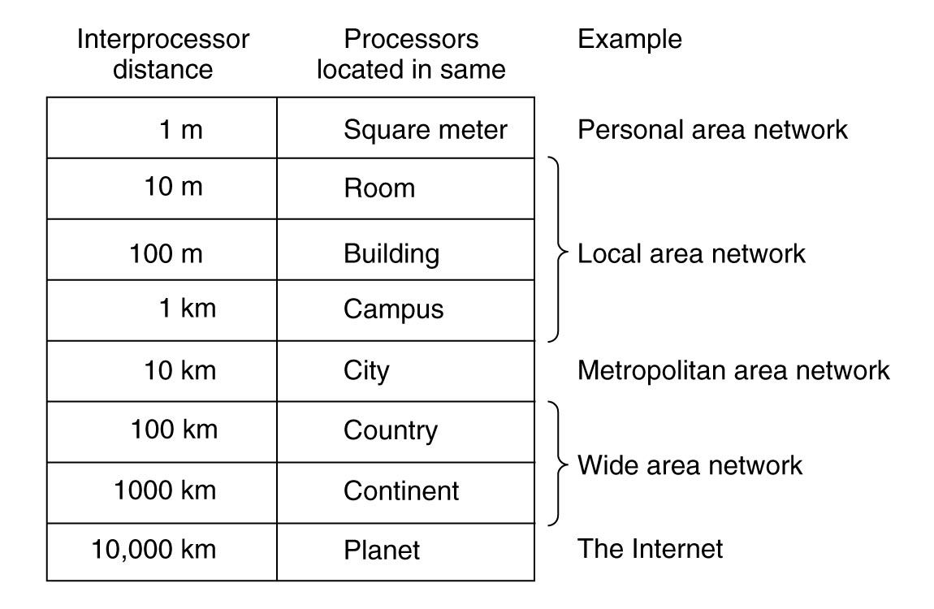
Fig. 1-6 Classification of interconnected processors by scale
Computer Networks -1-Part 1

Slide 26
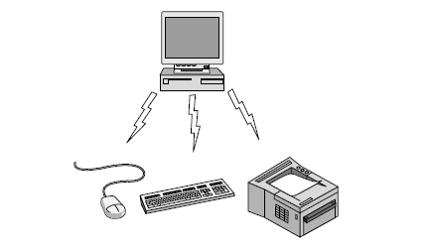
1.2.1 Personal Area Networks(PAN)
Connect devices over the range of a person
Example of a Bluetooth (wireless) PAN:
Fig. 1-7 Bluetooth PAN configuration.
Computer Networks -1-Part 1

Slide 27
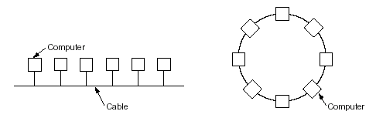
1.2.2 Local Area Networks(LAN)
Apart from scale, LANs distinguish themselves from other networks by (generally) using broadcast technology, and having simple topologies:
switch
Fig. 1-7 Two broadcast networks. (a) Bus. (b) Ring.
The Star
Computer Networks -1-Part 1

Slide 28
Type (a) (Bus-based): All computers are connected to the same wire. When one of them starts sending, the signal is propagated to all others. If two of them start sending at the same time, packets collide and rubbish is the result.
Type (b) (Token-based): a token (which is just a small packet) continuously circulates along the ring. A sending computer:
(1) waits until the token passes and removes it
(2) sends its packet along the ring
(3) waits until the packet returns
(4) reinserts the token
The star is the most commonly used today
Computer Networks -1-Part 1

Slide 29
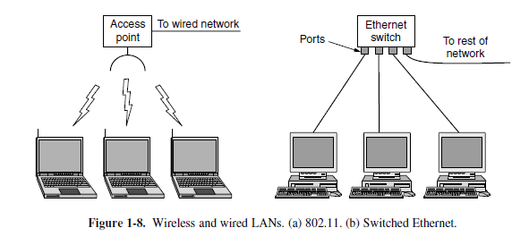
Local Area Networks
Connect devices in a home or office building
Called enterprise network in a company
Computer Networks -1-Part 1

Slide 30
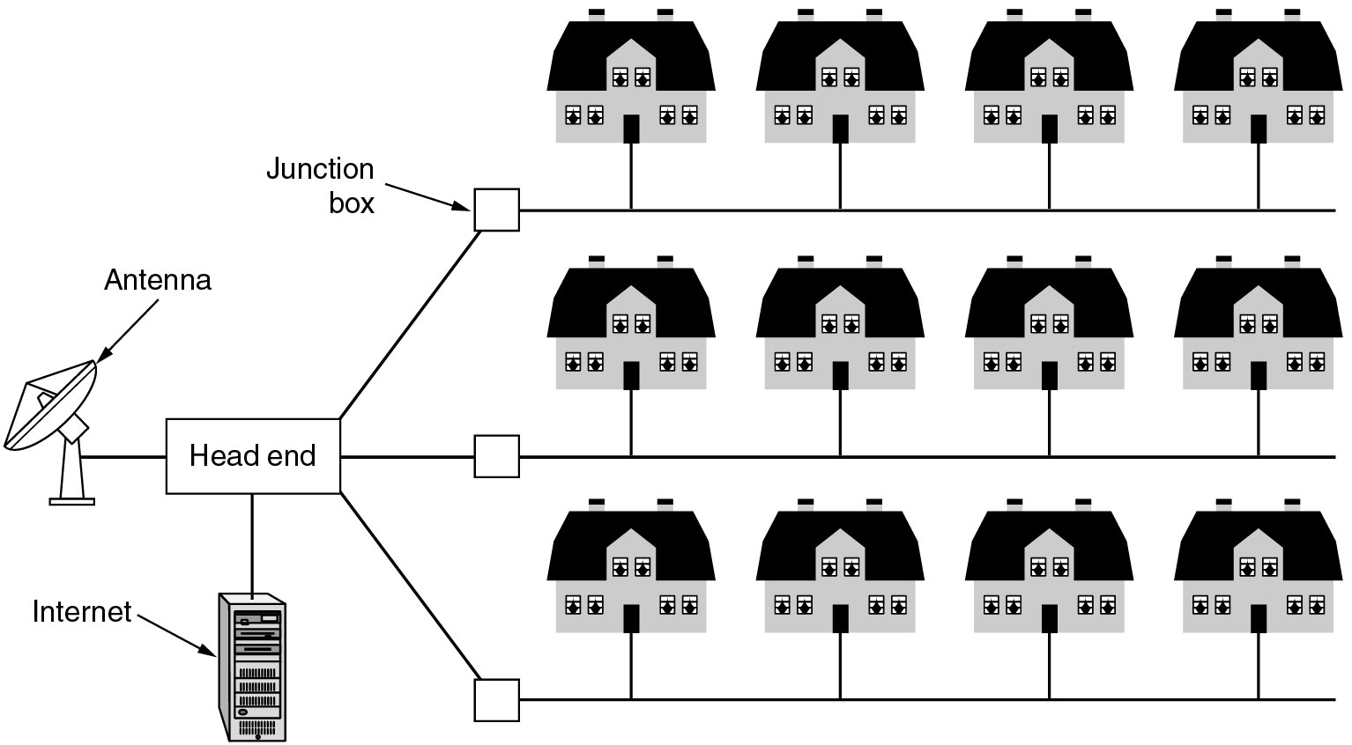
Metropolitan Area Networks
1.2.3 Metropolitan Area Networks (MAN)
Fig. 1-8. A metropolitan area network based on cable TV.
Computer Networks -1-Part 1

Slide 31
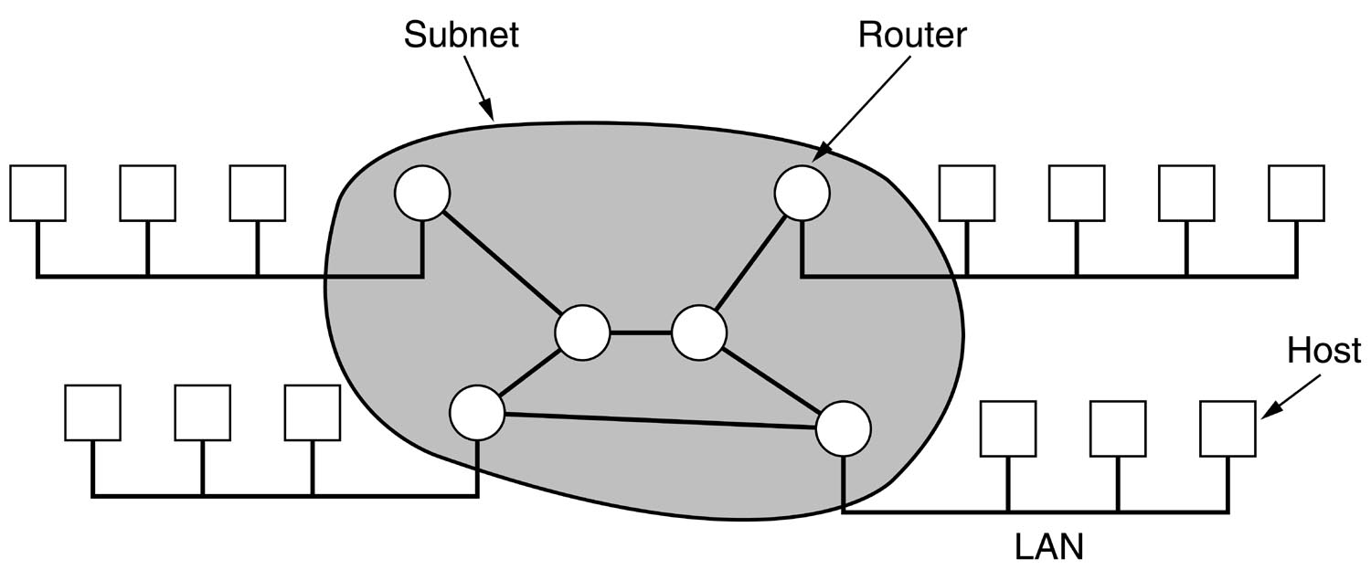
1.2.4 Wide Area Networks (WAN)
Note: LANs and MANs generally don’t have any switching elements: the wire does all the work. This makes them extremely efficient, although harder to scale. Here’s where WANs come in.
Fig. 1-9. Relation between hosts on LANs and the subnet
Computer Networks -1-Part 1

Slide 32
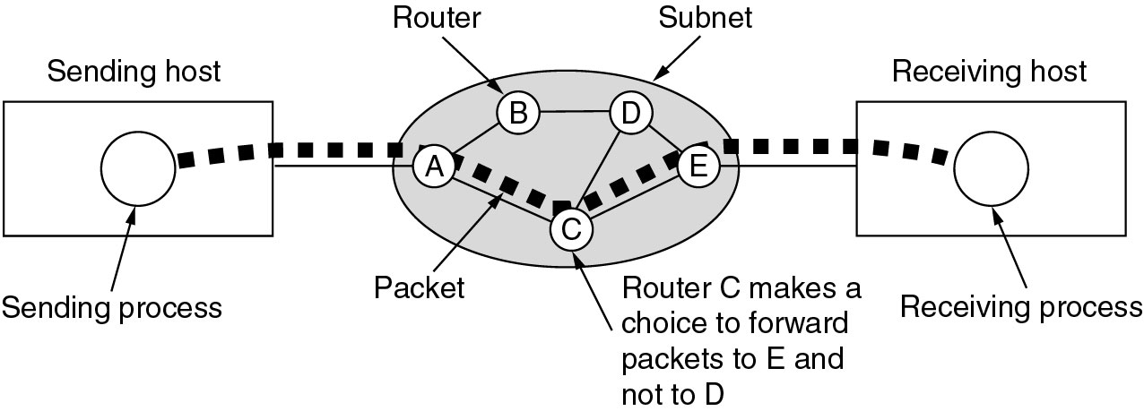
Wide Area Networks (2)
Fig. 1-10. A stream of packets from sender to receiver.
Computer Networks -1-Part 1

Slide 33
Wide Area Networks (3)
In a WAN, hosts are connected to a subnet, which in turn consists of routers (switching elements) and trunks.
Routers generally adhere to a store-and-forward principle: incoming packets are first buffered (stored), the router takes a decision on where the packet has to go, and forwards the packet across the selected output line.
Computer Networks -1-Part 1

Slide 34
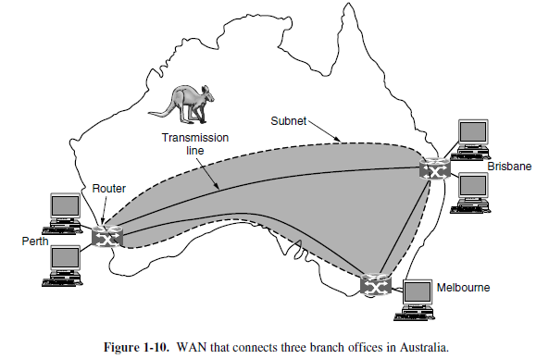
Wide Area Networks
Connect devices over a country
Example WAN connecting three branch offices:
Computer Networks -1-Part 1

Slide 35
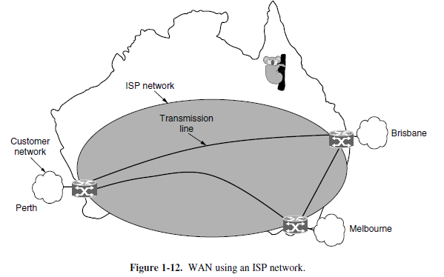
Wide Area Networks
An ISP (Internet Service Provider) network is also a WAN.
Customers buy connectivity from the ISP to use it.
Computer Networks -1-Part 1

Slide 36
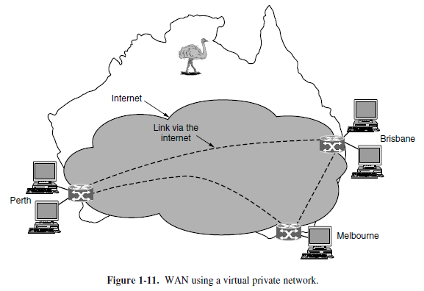
Wide Area Networks
A VPN (Virtual Private Network) is a WAN built from virtual links that run on top of the Internet.
Computer Networks -1-Part 1

Slide 37
WAN consists of two subnets
Resource subnet
  Includes computers, terminals, programs, etc.
  Responsible for information processing
Communication subnet:
  Includes transportation lines, switching elements(routers and switches, etc.)
  Responsible for information delivery and distribution
Computer Networks -1-Part 1

Slide 38
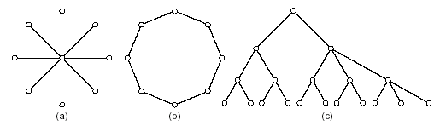
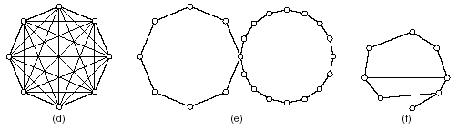
WAN Topologies
Note: In contrast to LANs and MANs, the organization of a WAN in terms which hosts are interconnected is important
Observation: Most often you’ll see arbitrary topologies; the others are used in application-specific ways (mostly star, ring, and tree)
Computer Networks -1-Part 1

Slide 39
1.2.5 Internetworks (1)
The assumption so far is that a network is homogeneous: there is hardly any variation in hardware and software. In practice, large networks can only be constructed by interconnecting different kinds of networks, internet(work).
Heterogeneous
  hardware and software are variable
Computer Networks -1-Part 1

Slide 40
1.2.6 Internetworks (2)
Examples:
Connecting a collection of different kinds of LANs (bus-based to token-based) within a department.
Connecting LANs to each other through a WAN (think of enterprise networks for multinationals). The WAN acts as a subnet.
Connecting WANs to each other (the Internet).
Computer Networks -1-Part 1

Slide 41
1.3 Network Software
1.3.1. Protocol Hierarchies
To reduce design complexity, most networks are organized as a series of layers, each layer offers certain services to its upper layer.
Layer n on one machine carries on a conversation with layer n on another machine. The rules and conventions used in this conversation are collectively known as the layer n protocol.
Computer Networks -1-Part 1

Slide 42
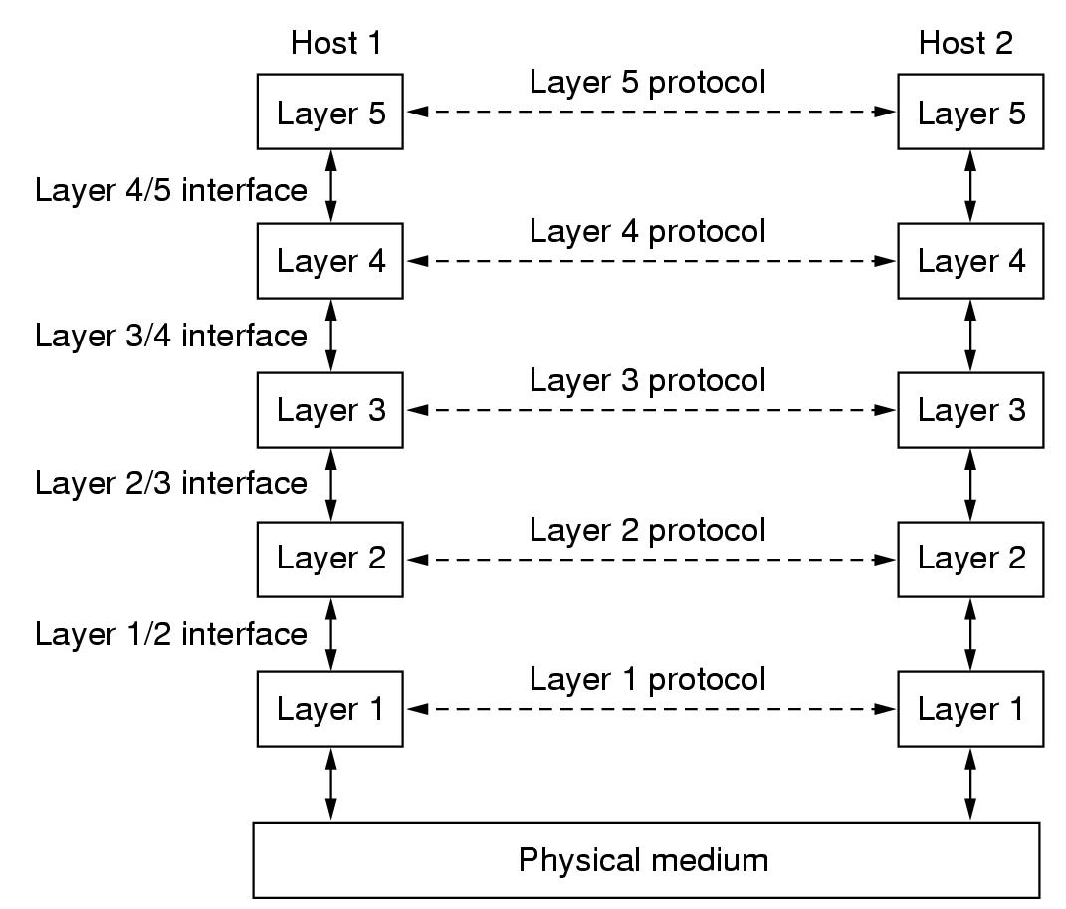
Fig.1.13 Layers, protocols, and interfaces
Computer Networks -1-Part 1

Slide 43
What’s a protocol?
human protocols:
“what’s the time?”
“I have a question”
introductions
… specific msgs sent
… specific actions taken when msgs received, or other events
network protocols:
machines rather than humans
all communication activity in Internet governed by protocols
protocols define format, order of msgs sent and received among network entities, and actions taken on msg transmission, receipt
Computer Networks -1-Part 1

Slide 44



What’s a protocol?
a human protocol and a computer network protocol:
Hi
TCP connection
request
Hi
TCP connection
response
Got the
time?
Get http://www.awl.com/kurose-ross
2:00
<file>
time
Computer Networks -1-Part 1

Slide 45
Some terminologies (1)
Layers
  Networks are organized as a stack of layers or levels, each one built upon the one below it
Protocol
  An agreement between the communicating parties on how communication proceed
Peer
  The entities comprising the corresponding layers on different machines are called peers
Interface
  Defines which primitive operations and services the lower layer makes available to the upper one
Computer Networks -1-Part 1

Slide 46
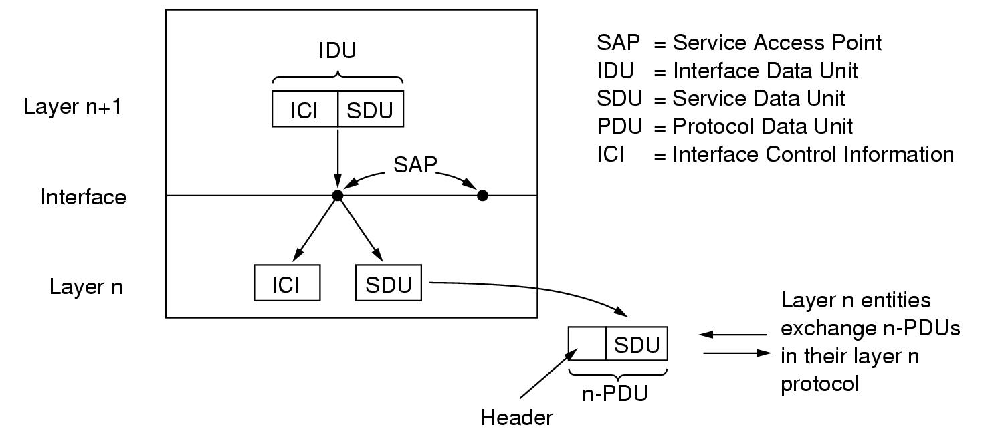
Interfaces and Services
Relation between layers at an interface
Computer Networks -1-Part 1

Slide 47
A Service Access Point is identified by an address, and forms the interface to a set of services.
The Service Data Unit contains the data you want to send.
The Interface Control Information contains info needed to send the SDU, e.g. number of bytes.
The Protocol Data Unit is the data that is sent across the network, containing your SDU as well as protocol-specific data.
Computer Networks -1-Part 1

Slide 48
Some terminologies (2)
Network Architecture
  A set of layers and protocols, together with interfaces between layers, is called Network Architecture.
Protocol stack
  A list of protocols used by a certain system, one protocol per layer, is called a protocol stack.
protocol hierarchies
  Fundamental to all software that makes a computer network run, is the notion of protocol hierarchies: structuring the services that a network must offer in terms of layers.
Computer Networks -1-Part 1

Slide 49
Protocol “Layers”
Networks are complex!
many “pieces”:
  hosts
  routers
  links of various media
  applications
  protocols
  hardware, software
Question:
Is there any hope of organizing structure of network?
Or at least our discussion of networks?
Computer Networks -1-Part 1

Slide 50
Organization of air travel
ticket (purchase)
baggage (check)
gates (load)
runway takeoff
airplane routing
ticket (complain)
baggage (claim)
gates (unload)
runway landing
airplane routing
airplane routing
a series of steps
Computer Networks -1-Part 1

Slide 51

Layering of airline functionality
ticket (purchase)
baggage (check)
gates (load)
runway (takeoff)
airplane routing
ticket (complain)
baggage (claim
gates (unload)
runway (land)
airplane routing
ticket
baggage
gate
takeoff/landing
airplane routing
airplane routing
airplane routing
departure
airport
intermediate air-traffic
control centers
arrival
airport
Layers: each layer implements a service
  via its own internal-layer actions
  relying on services provided by layer below
Computer Networks -1-Part 1

Slide 52
Why layering?
Dealing with complex systems:
explicit structure allows identification, relationship of complex system’s pieces
  layered reference model for discussion
modularization eases maintenance, updating of system
  change of implementation of layer’s service transparent to rest of system
  e.g., change in gate procedure doesn’t affect rest of system
layering considered harmful?
Computer Networks -1-Part 1

Slide 53
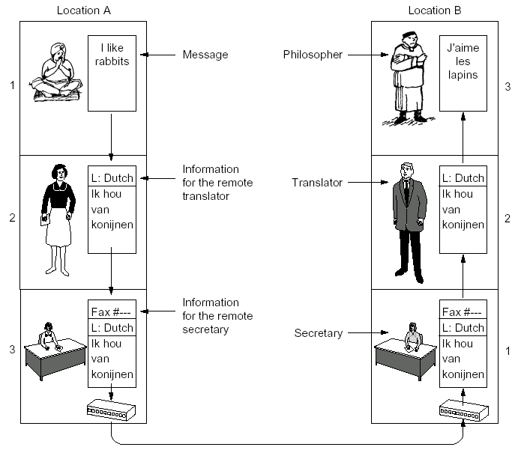
Fig.1.14 The philosopher – translator – secretary architecture
Computer Networks -1-Part 1

Slide 54
Layering: The Concepts (1)
Two parties at different sites, but at the same level, always agree on how they will exchange information: specified in a protocol. Example: we all agree to speak Chinese (but use English on the sheets).
In order for one party to send and receive information, it can only make use of the communication services offered by the layer directly underneath it.
Example: The use of interpreters in negotiations between countries.
Computer Networks -1-Part 1

Slide 55
Layering: The Concepts (2)
Services offered by a layer are always fully specified in terms of an interface that makes those services accessible. Example: phones have buttons that allow you to “dial” a number.
Protocol: A set of rules and specifications for peer-to-peer virtual communication, it is “horizontal”.
Service: A set of communication abilities and operations provided by lower layer to its higher layer, it is “vertical”.
Computer Networks -1-Part 1

Slide 56
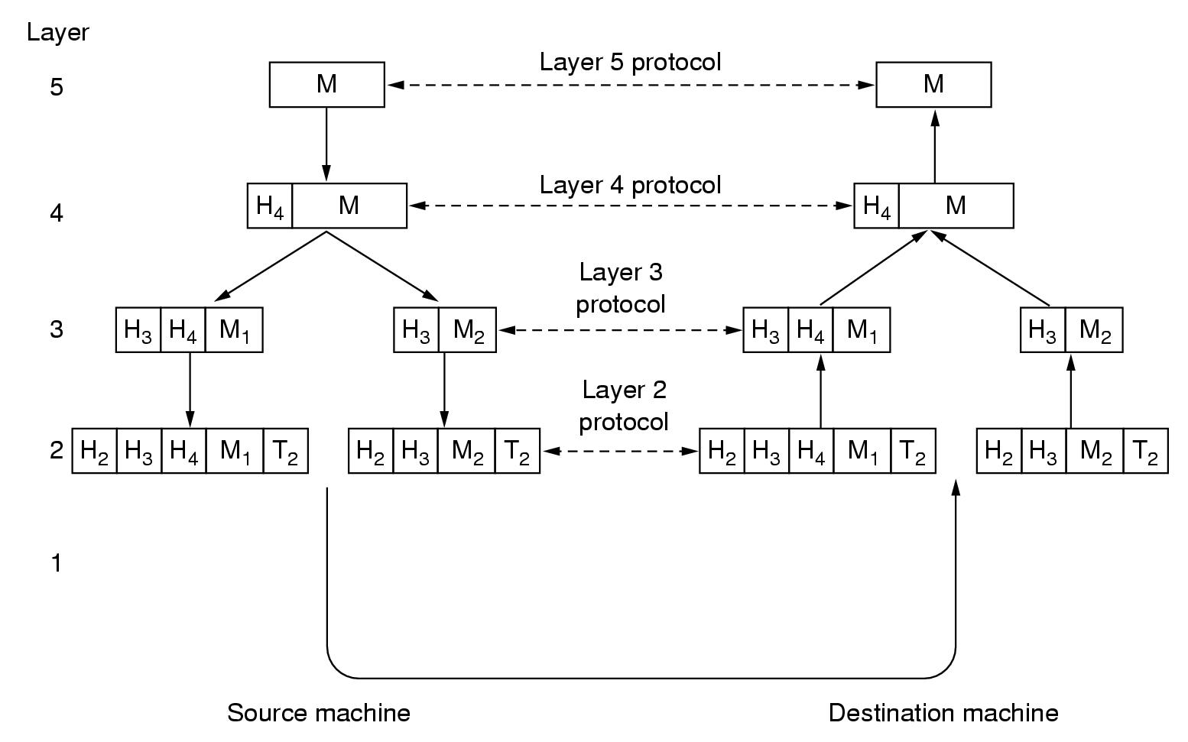
Layering: An Example
Fig.1.15 Information flow supporting virtual communication in layer 5
Computer Networks -1-Part 1

Slide 57
Observation: In a protocol stack, Layer k puts its entire packet as data into a Layer k-1 packet, that is, the k-1 packet payload; the latter may add a header and/or a trailer.
Note: It may even occur that Layer k data has to be split across several Layer k-1 packets, i.e., fragmentation. At the destination, reassembly is needed to recover Layer k data.
Computer Networks -1-Part 1

Slide 58
1.3.2 Design Issues for the Layers (1)
Addressing
  Mechanism for identifying senders and receivers: addressing to specify a party
Rules for data transfer
  Simplex communication, SDX
  Half-duplex communication, HDX
  Full-duplex communication, FDX
Error control
  Physical communication circuits are not perfect, so that error-detecting and error-correcting code are used. In addition, receiver must have some way of telling the sender which messages have been correctly received and which have not.
Computer Networks -1-Part 1

Slide 59
1.3.2 Design Issues for the Layers (2)
Sequencing
  Keep the messages order
Flow control
  Keep a fast sender from swamping a slow receiver with data
Disassembling and reassembling
  Allow all processes to accept arbitrarily long messages
Multiplexing
  Use the same connection for multiple, unrelated conversations
Routing
  Select a route from multiple paths between source and destination
Computer Networks -1-Part 1

Slide 60
1.3.3 Connection-oriented and Connectionless Services (1)
What is service?
  A set of communication abilities and operations provided by lower layer to its higher layer.
Connection-oriented Service
  Like the telephone model: you first establish a connection, then do a lot communication, and finally release the connection. Three phases.
Computer Networks -1-Part 1

Slide 61
Services: Connections or Not (2)
Connectionless: Like the postal model: your data is put into some kind of envelope called packet, on which the destination address has been written. The envelope + contents (packet) is independently routed in communication subnet, until gets to the destination, and that’s it.
Computer Networks -1-Part 1

Slide 62
Services: Connections or Not (3)
Each service can provide some quality:
  Is data delivered in the order it was sent? With connections, this is generally the case.
  Is data transmission reliable? Generally offered with connections, but not always with connectionless services. Reliability requires sending acknowledgements, so that performance may degrade.
Computer Networks -1-Part 1

Slide 63
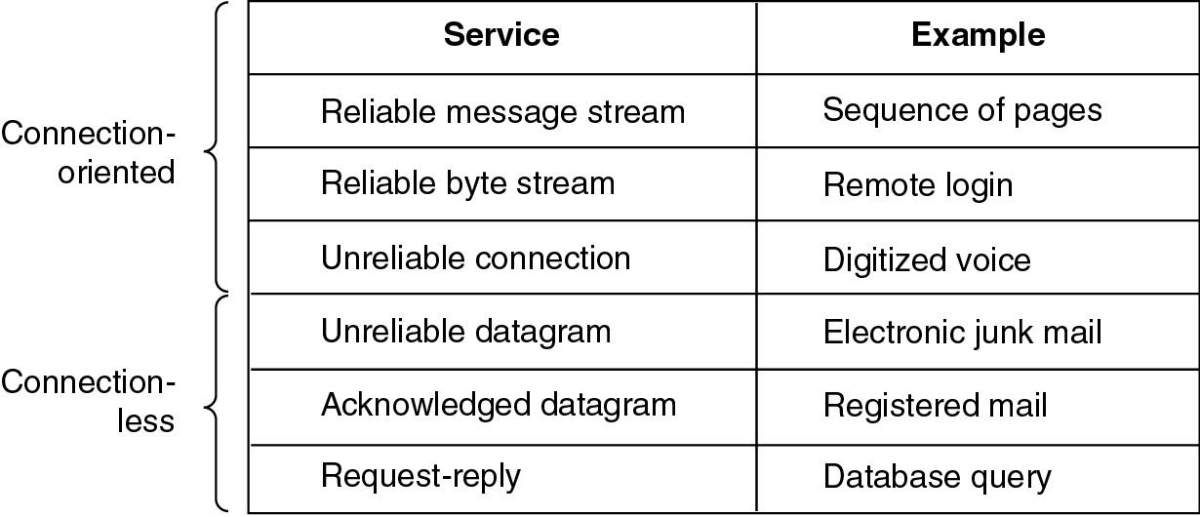
Connection-Oriented and Connectionless Services (4)
Six different types of service
Computer Networks -1-Part 1

Slide 64
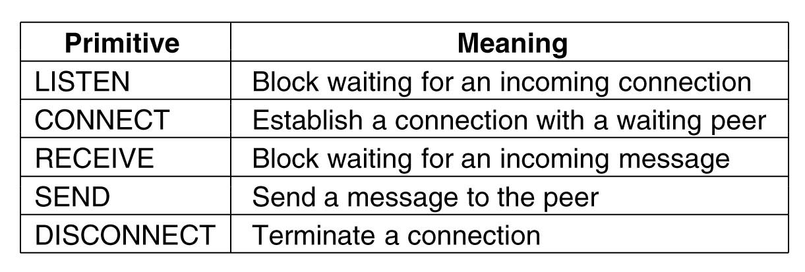
1.3.4 Service Primitives
Services are generally specified by a set of primitives (operations), which tell the service to perform some action or report on an action taken by a peer entity. Primitives are normally system calls.
Computer Networks -1-Part 1

Slide 65
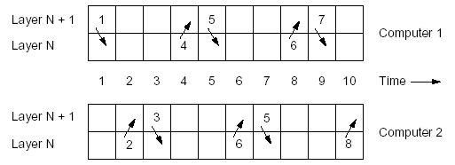
1. CONNECT.request: request for establishing a connection (dial a phone number).
2. CONNECT.indication: signal the callee (phone rings).
3. CONNECT.response: reaction by callee to indication (pick up the phone).
4. CONNECT.confirm: tell caller whether call was accepted (caller hears ringing stop).
5. DATA.request: request data to be sent (say something)
6. DATA.indication: signal arrival of data (callee hears you)
7. DISCONNECT.request: request release of connection (caller hangs up)
8. DISCONNECT.indication: signal release of connection (callee hears busy tone)
Computer Networks -1-Part 1

Slide 66
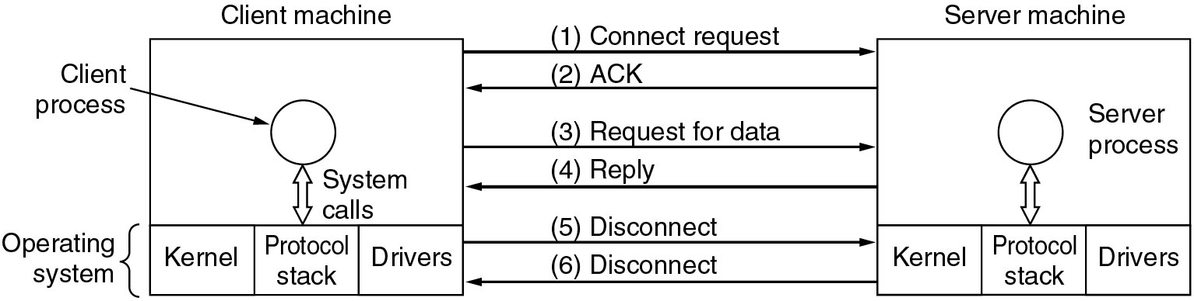
Service Primitives (2)
Packets sent in a simple client-server interaction on a connection-oriented network.
Computer Networks -1-Part 1

Slide 67
1.3.5 The Relationship of Services to Protocols
Service
  is a set of primitives (operations) that a layer provides to the layer above it, defining what operations the layer is prepared to perform on behalf of its users, but nothing about how these operations are implemented.
Protocol
  is a set of rules governing the format and meaning of the packets, or messages that are exchanged by the peer entities within a layer. Entities use protocols to implement their service definitions.
Computer Networks -1-Part 1

Slide 68
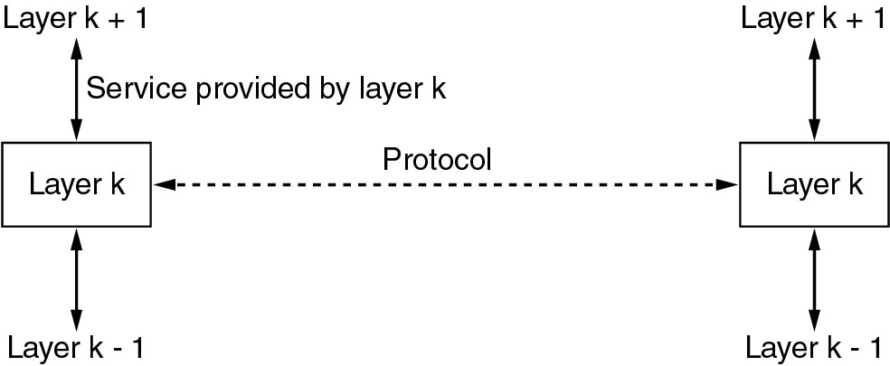
1.3.5 The Relationship of Services to Protocols
Fig. 1.19 The relationship between a service and a protocol
Computer Networks -1-Part 1

Slide 69
End of part 1
Computer Networks -1-Part 1

